Slide 1
Numerical Analysis (2/7) Interpolation
University of Luxembourg - 2024
Master in Mathematics
Hadrien Beriot
Restricted

Slide 2
Outline
1. Overview
2. Polynomial interpolation
3. Polynomial approximation theory
4. Discrete Least Squares – polynomial data fitting

Slide 3

1. Overview

Slide 4
Discrete Data
t | 1.0 | 2.0 | 3.0 | 4.0 | 5.0 | 6.0
y | 1.9 | 2.7 | 4.8 | 5.3 | 7.1 | 2.4
There are many diﬀerent things we might want to do with such data.
Plot data on a graph and draw a curve through the data points
Infer data values between the points or predict values beyond the available data
Determine important parameters (e.g. birth/death rates) if the data represents a physical phenomenon
Approximate the derivative or integral, or quickly evaluate the function, if the data represents an underlying function
…
Objective: represent discrete data in terms of relatively simple functions for easy manipulation
Notes:
Steps 2 and 3—designing, analyzing, implementing, and
using numerical algorithms and software—are the main subject matter of scientiﬁc
computing, and of this course

Slide 5
The Importance of Interpolation
Traditionally, interpolation was used to compute approximate values of mathematical functions between tabulated values
Advent of computers/calculators has reduced this application, but interpolation remains a cornerstone of numerical analysis
But interpolation is more than just a data manipulation technique
Discrete → Continuous:
representing discrete data as a function (vs. a table) is key to bridging finite- and infinite-dimensional problems

Slide 6
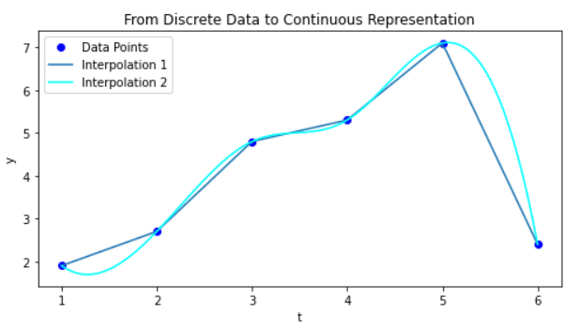
The Importance of Interpolation
t | 1.0 | 2.0 | 3.0 | 4.0 | 5.0 | 6.0
y | 1.9 | 2.7 | 4.8 | 5.3 | 7.1 | 2.4
Discrete
interpolation
Continuous
Notes:
What can you say about what you see?
Not unique
One has continuous derivatives, other one does not

Slide 7
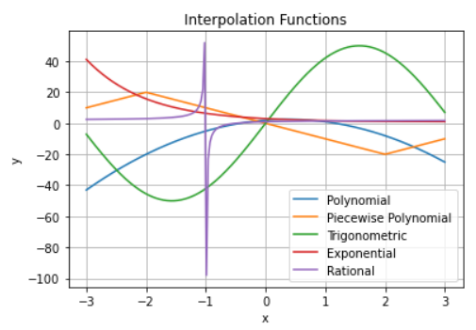
Type of functions used in interpolation
Exercise:
Can you recognize some of the function types used here?

Slide 8
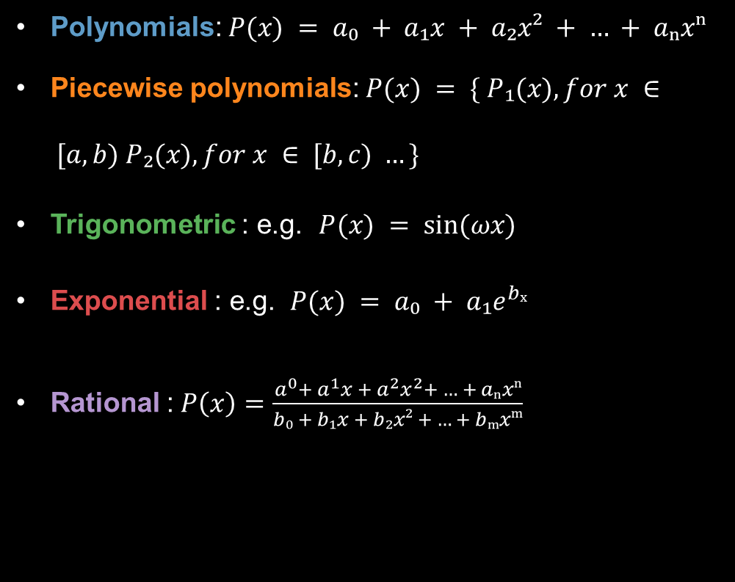
Type of functions used in interpolation
Polynomials: $P(x) = a₀ + a₁x + a₂x² + … + aₙxⁿ$
Piecewise polynomials: $P(x) = \{ P₁(x), for x ∈ [a, b) P₂(x), for x ∈ [b, c) …\}$
Trigonometric : e.g. $P(x) = sin⁡(ωx)$
Exponential : e.g. $P(x) = a₀ + a₁e^{bₓ}$
Rational : $P\left(x\right)=\frac{a^{0}+ a^{1}x + a^{2}x^{2}+ … + aₙxⁿ}{b₀ + b₁x + b₂x² + … + bₘxᵐ}$

Slide 9
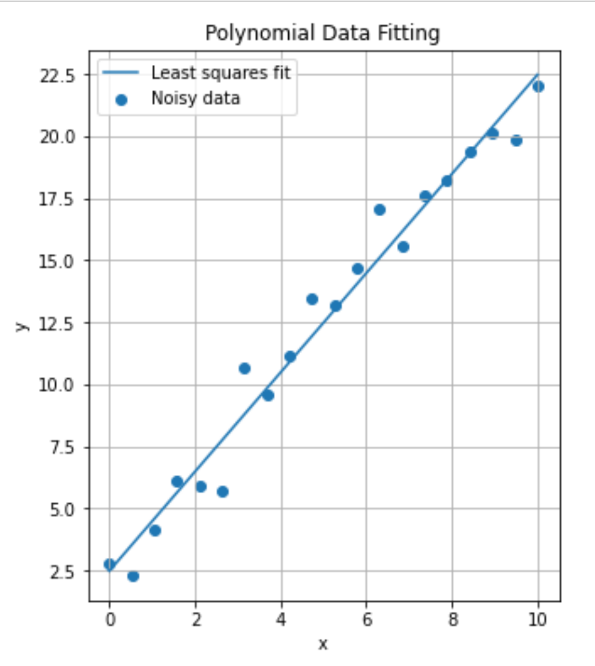
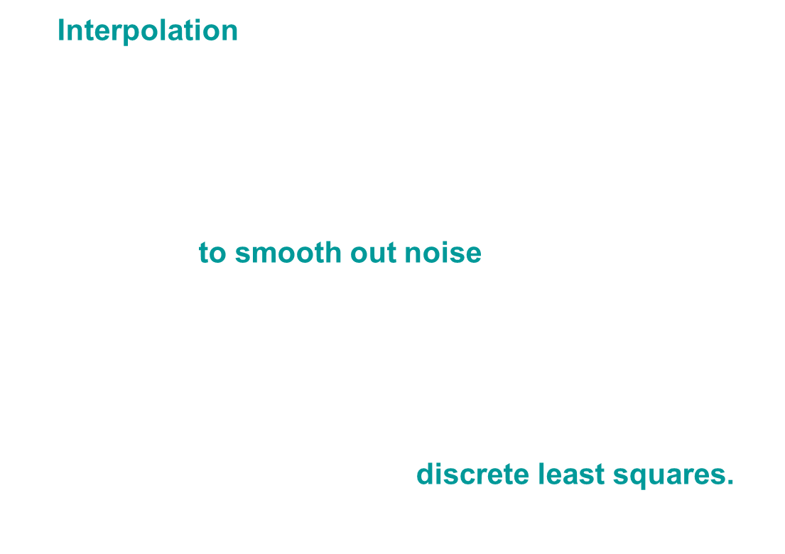
Polynomial Interpolation vs approximation
Interpolation = Exact Data Fit
In some cases (noisy or too much data), exact data fit not always appropriate
If data has experimental/significant errors, it's preferable to smooth out noise
We do not need $P$ to pass through $x_{i}$ , but only capture the main trend of $f$
we can try to fit the data to a polynomial $P$ of lower degree $n$, we talk about discrete least squares.
Notes:
Steps 2 and 3—designing, analyzing, implementing, and
using numerical algorithms and software—are the main subject matter of scientiﬁc
computing, and of this course

Slide 10
2. Interpolation

Slide 11
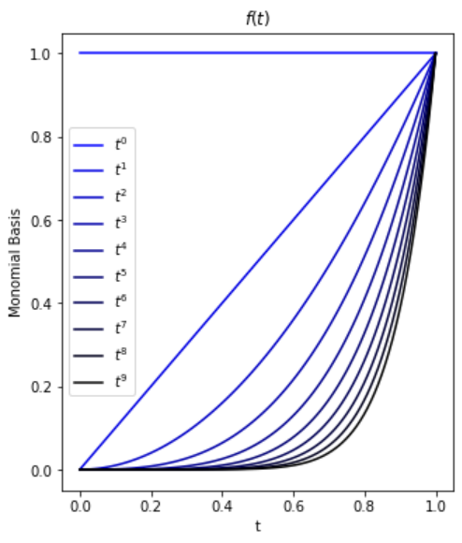
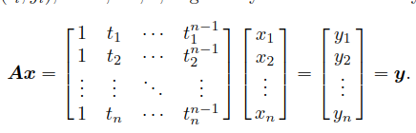

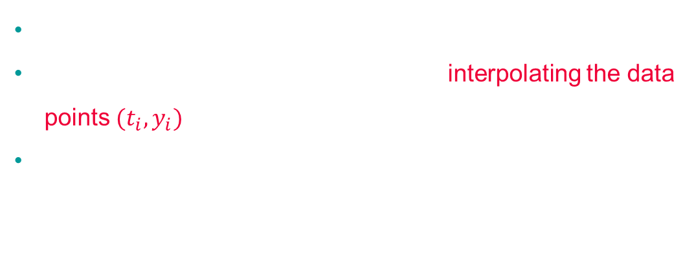
Monomial basis
To interpolate n data points: $k = n−1$
Monomials are the most natural basis for $P_{n−1}$
$p_{n−1} (t) = x_{1} + x_{2}t + · · · + x_{n}t_{n−1}$
A matrix of this form is called a Vandermonde matrix
This system gives the coefficients for interpolating the data points $(t_{i}, y_{i})$
This matrix is often ill-conditioned for high-degree polynomials
Notes:
Matrix whose columns are successive powers of some independent variable t

Slide 12
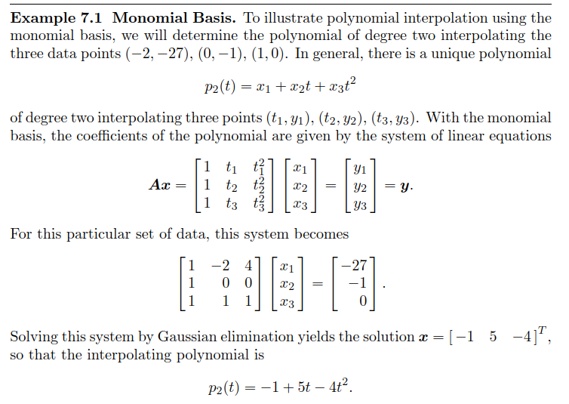
Exercise: pen and paper

Slide 13

Sources of Approximation
Modeling (friction/viscosity/air resistance)
Measurements (noise)
Previous computations (inaccurate inputs)
Truncation / discretization / computational: from continuous to discrete
Rounding: computer floating-point representation
In this course, we focus on 4. and 5.

Slide 14
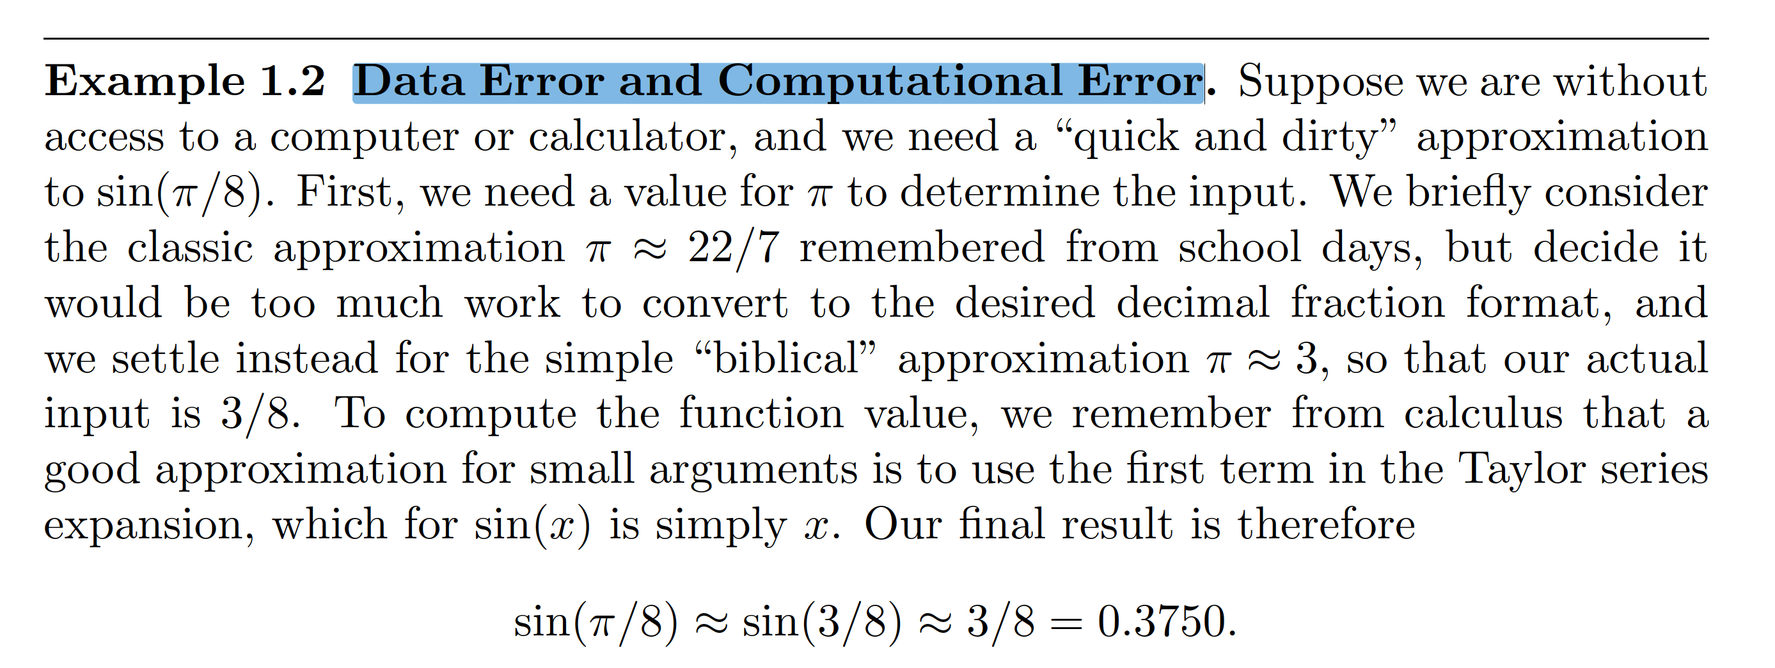
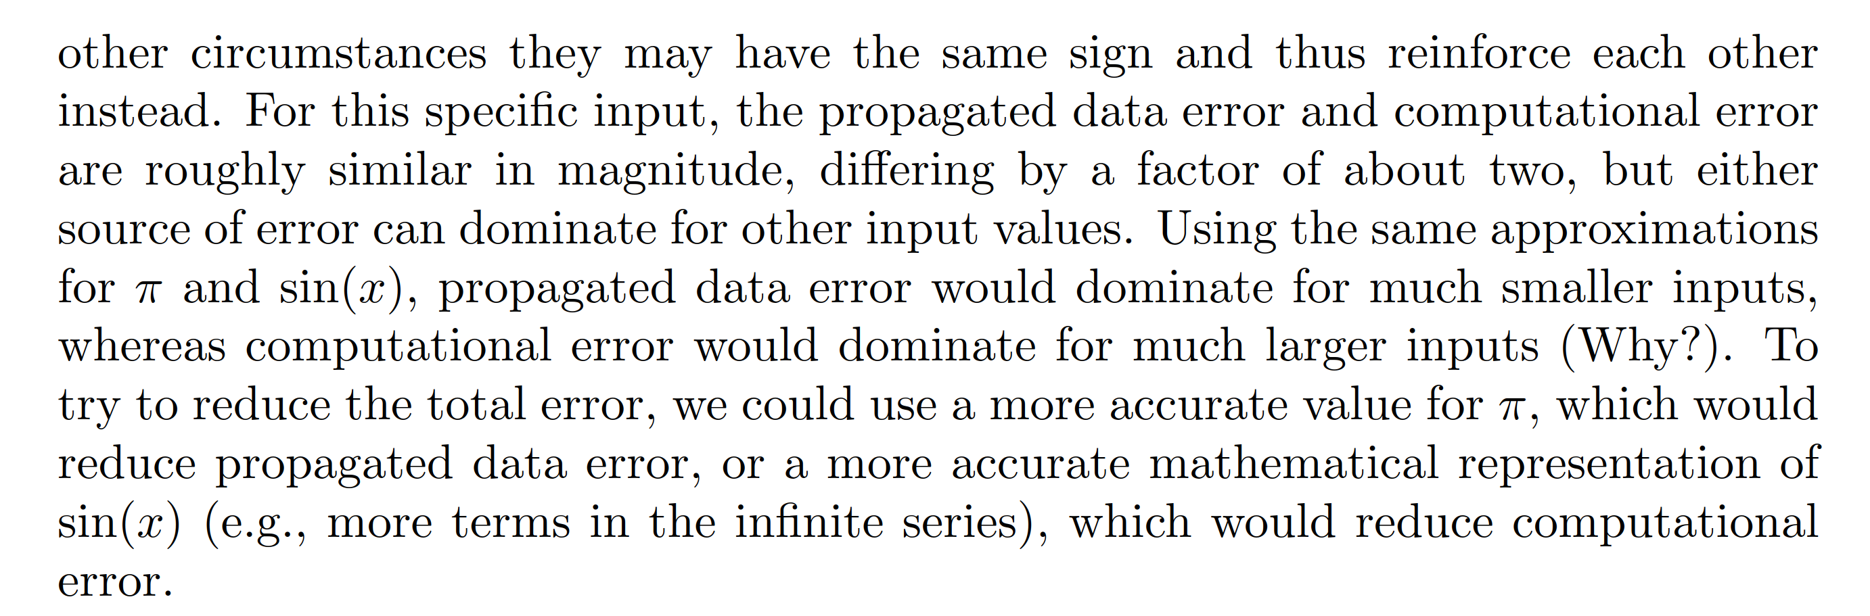
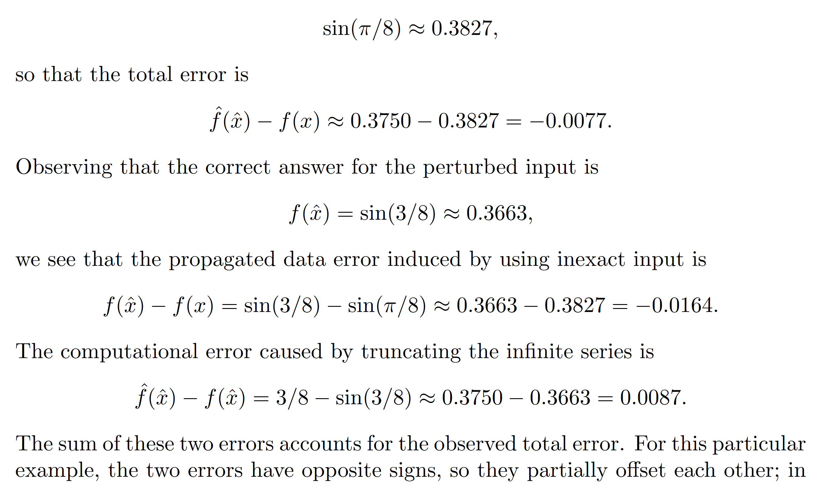
Example 1 - Data Error and truncation Error
Check if you want to add this, could be an exercise
Notes:
some customers want extreme accuracy – although there are huge uncertainties in their model

Slide 15
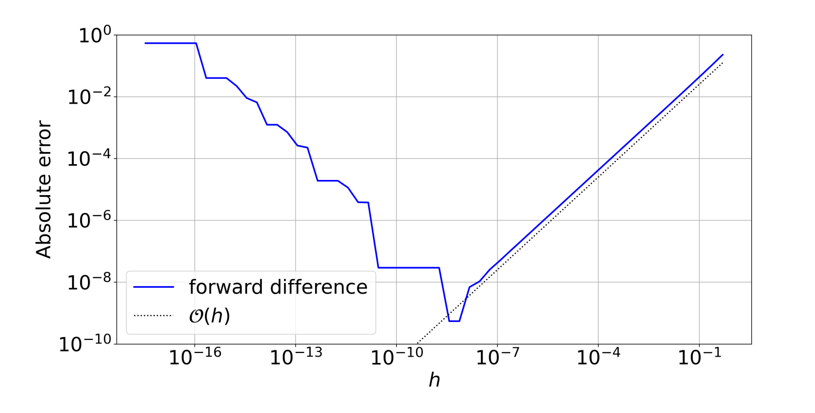
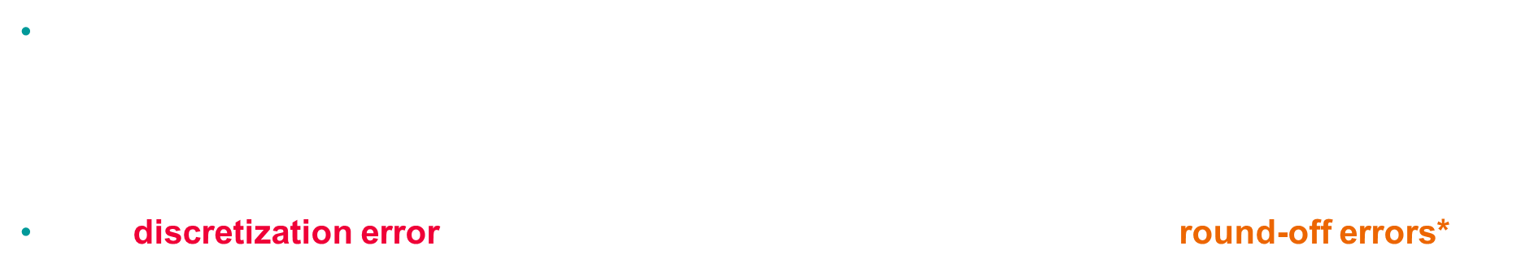
Round-off vs discretization errors An example
Exercise 2
Derivative approximation (see exercise)
$$f^{′}\left(x_{0}\right)=\frac{f\left(x_{0}+h\right)−f\left(x_{0}\right)}{h}+O(h)$$
The discretization error is linear with $h,$ but when h is too small, we have round-off errors*
Total error
Rounding error
Discretization
Error
*today’s topic, computer floating-point representation
Notes:
First order Finite difference

Slide 16

1.3 Representation of real numbers

Slide 17


Floating-point representation
A computer has a finite capacity and cannot store all real numbers (π ≈ 3.14159...)
Floating point representation of $x∈R$
$$fl\left(x\right)=±m×b^{e}, m=(\frac{d_{0}}{b^{0}}+\frac{d_{1}}{b^{1}}+…+\frac{d_{0}}{b^{p−1}})$$
m is the mantissa, e: exponent, b: basis, p: precision
In base 10, floating point ⬄ usual scientific notation
Let us choose $fl\left(x\right)= 152 853.50, b = 10, p = 8, e = 5$
$152853.50 = 1.5285350 ×{10}^{5}=\left(1×{10}^{0}+5×{10}^{−1} +…+0×{10}^{−7} \right)×{10}^{5}$
Notes:
The key idea is that both representations allow for expressing very large or very small numbers efficiently by focusing on the most significant digits and scaling with powers of 10. However, floating-point representation is used in computing and has specific rules for how numbers are stored in binary (even though the conceptual structure is similar to scientific notation).

Slide 18
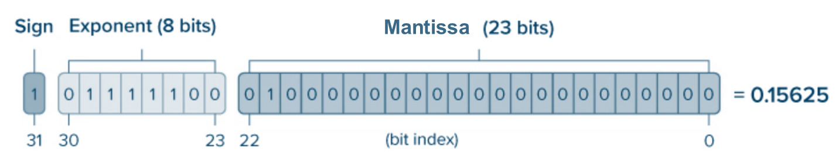

Floating-point representation single precision (IEEE-754) – 32 bits
A floating-point system is characterized by 4 values:
$(b, p, U, L)$base, precision, exponent upper and lower bound such as $L ≤ e ≤ U$
Single precision format (32 bits storage) – IEEE 754 standard
$b=2, p=23, L=−126, U=127$
$${\left(−1\right)}^{sign}×(1+Mantissa)×2^{ Exponent−127}$$
Notes:
Computer encodes in base 2, not in base 10 and it uses a biased exponent to allow encoding small and large exponents

Slide 19
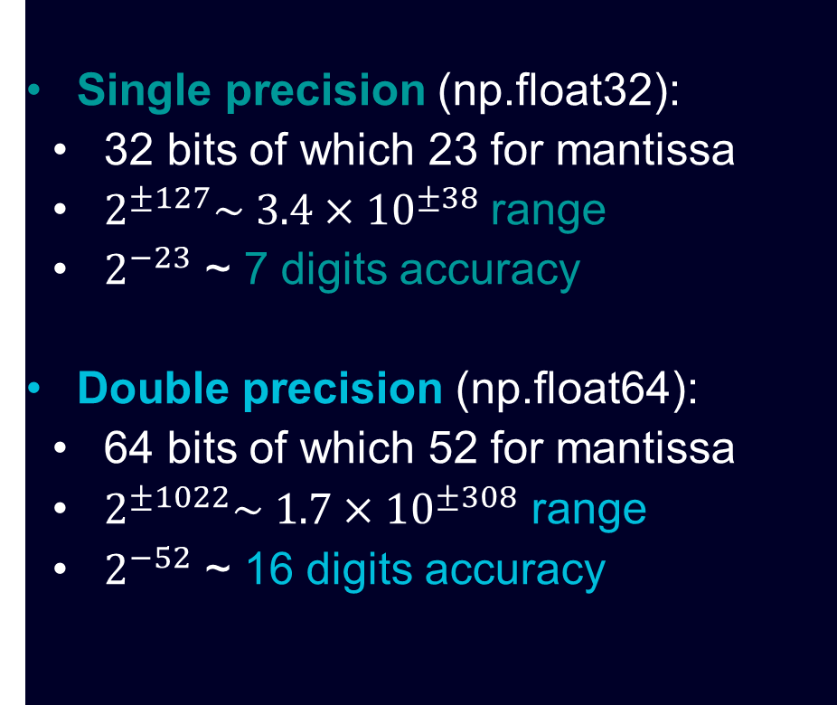

Single/double precision Example
Single precision (np.float32):
32 bits of which 23 for mantissa
$2^{±127}\sim 3.4×{10}^{±38}$ range
$2^{−23}$ ~ 7 digits accuracy
Double precision (np.float64):
64 bits of which 52 for mantissa
$2^{±1022}\sim 1.7×{10}^{±308}$ range
$2^{−52}$ ~ 16 digits accuracy
Example:
You are solving $Ax=b$ using an iterative solver (GMRES), but it's converging slowly.
You need to store 500 vectors, each representing a problem with 24 million degrees of freedom.
Question: How much RAM is required to store these vectors in double precision?
Notes:
24e6*(64/4 = 16) *500/1e9
ans =
192 Gb

Slide 20
1.4 Floating point arithmetic

Slide 21
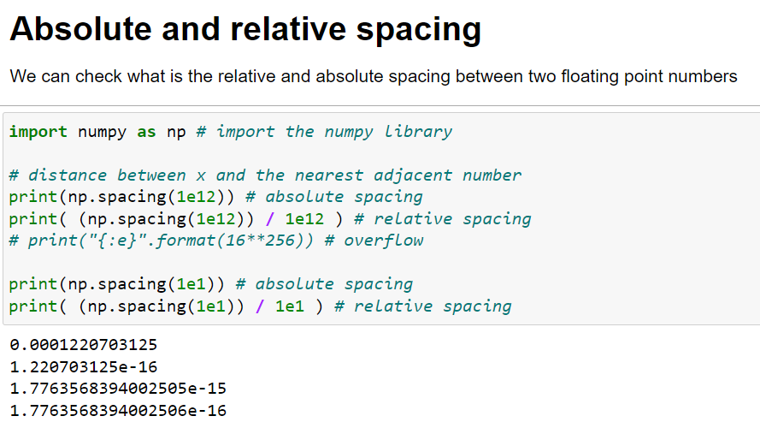
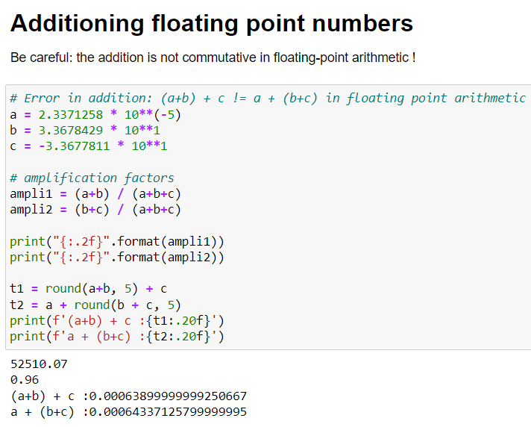
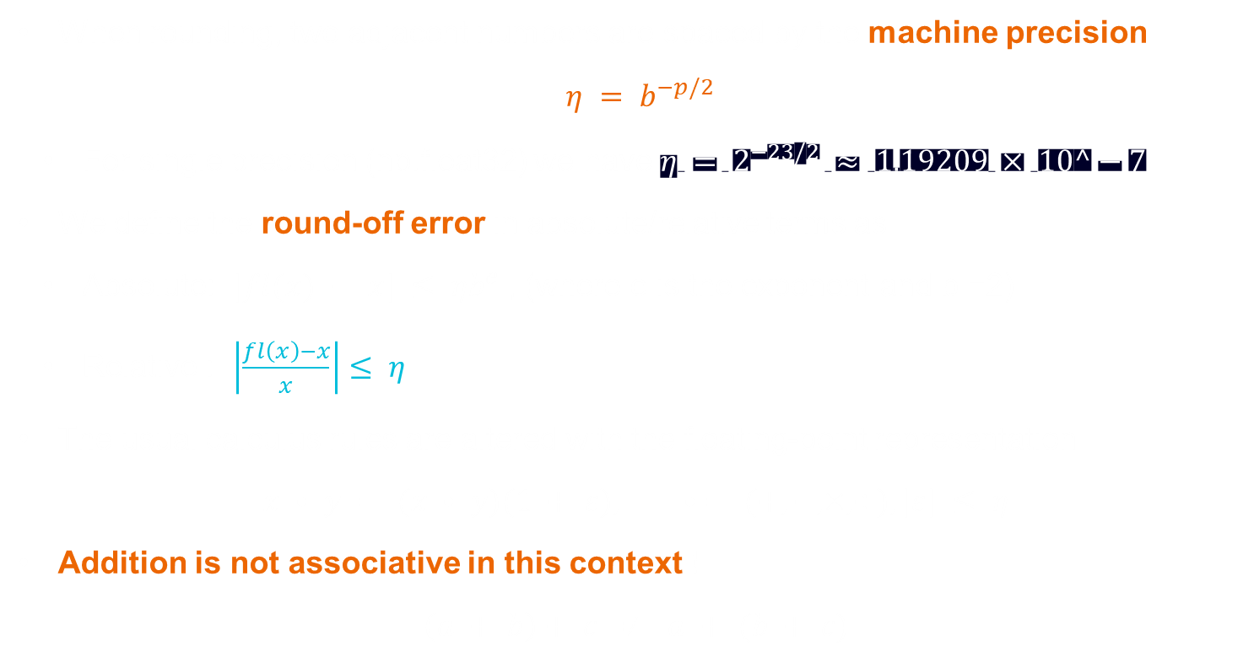
Machine precision
When rounding, two adjacent numbers are spaced by the machine precision
$η = b^{−p/2}$
For single precision (np.float32) we have $η = 2^{−23/2} ≈ 1.19209 × 10^−7$
We define the round-off error in absolute/relative terms as
Absolute: $|fl(x) − x| ≤ ηb^{e}$, (where e is the exponent and b =2)
Relative : $\left|\frac{fl\left(x\right)−x}{x}\right|≤ η$
The usual calculus rules are altered with the floating-point representation
$$x • y = (x • y)(1 + ε), • = (+, −, ×, ÷), |ε| ≤ η$$
Addition is not associative in this context !
$$\left(a + b\right)+ c ≠ a + (b + c)$$
Notes:
The spacing of a floating-point system is constant in the relative sense

Slide 22
Operations in floating point arithmetic

Slide 23
1.5 Conditioning and stability

Slide 24

Stability
Stability is an important concept in numerical analysis, and is found in different contexts:
Stability of numerical schemes (e.g. ODEs, finite differences),
Stability of numerical algorithms (e.g. linear systems),
It is linked to the propagation of errors during the computation.
Stability has also meanings at the continuous level (PDE, dynamical systems).

Slide 25
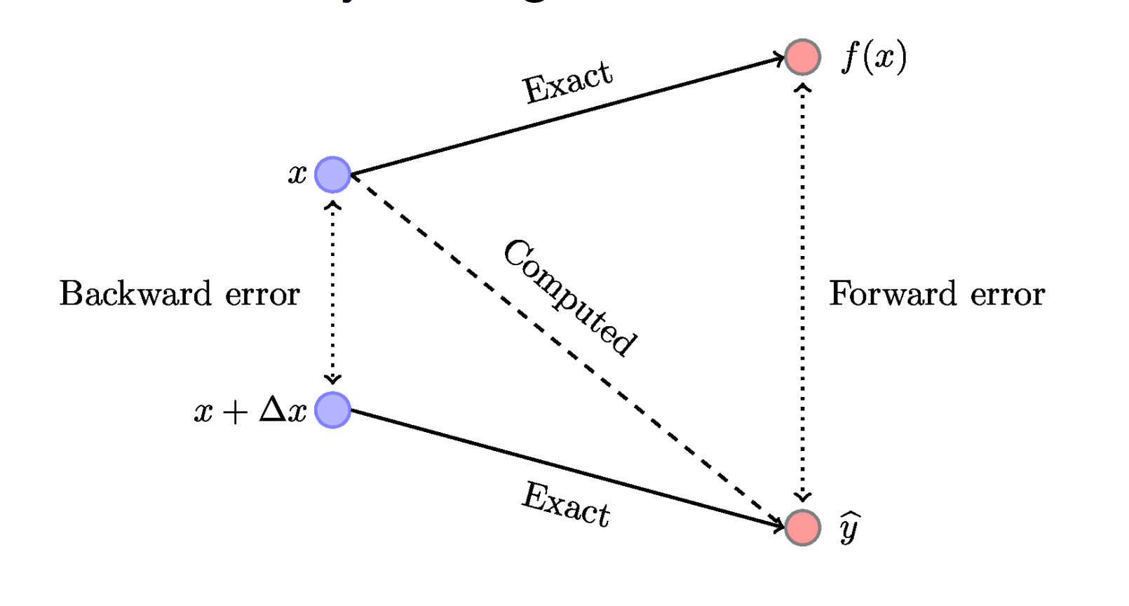
Stability
The forward error measures the difference between the computed and exact value $|\hat{y} − y|$
The backward error is the error on the input: $|\hat{x} −x|$, for a perturbed output $\hat{y}=f(\hat{x})$
If the backward error is “small”, we say the algorithm to be backward-stable
Illustration from Nicholas J. Higham blog

Slide 26
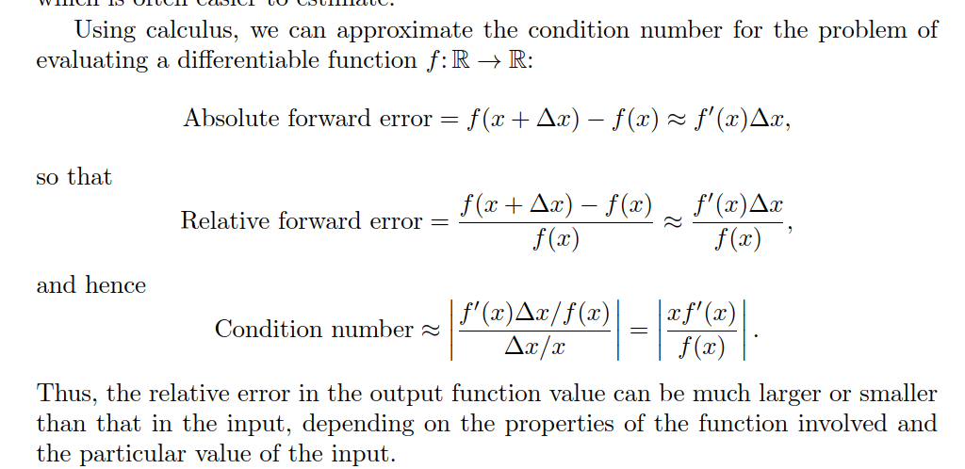
Conditioning
The condition number is the ratio of a relative change in the output to a relative change in the
Input. Condition number κ
κ = |(f (xˆ|)(−xˆ−f(xx)))/f (x)|
We have the relation
|relative forward error| = Condition number ×|relative backward error|
It represents the sensitivity related to the input data.
Conditioning depends on the problem, stability depends on the algorithm
For a C^1 function differentiable function f
κ = |(f (xˆ|)(−xˆ−f(xx)))/f (x)|= |xf’(x)/f(x)|
Notes:
We recognize the numerator and denominator in this ratio as the relative forward and backward errors, respectively, so this relationship can be rephrased
X_hat = x + delta x

Slide 27
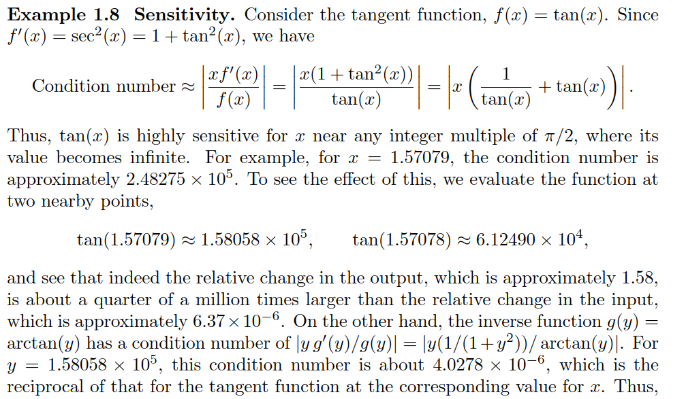
Could be an exercise
Notes:
1. Function: f(x)=xf(x) = \sqrt{x}f(x)=x​
Domain: x≥0x \geq 0x≥0
Derivative: f′(x)=12xf'(x) = \frac{1}{2\sqrt{x}}f′(x)=2x​1​
Conditioning:
As x→0+x \to 0^+x→0+, f′(x)→∞f'(x) \to \inftyf′(x)→∞, indicating high sensitivity (poor conditioning).
As xxx increases, f′(x)f'(x)f′(x) decreases, showing better conditioning for larger xxx.
Function: g(x)=a−xg(x) = a - xg(x)=a−x
Domain: All real numbers
Derivative: g′(x)=−1g'(x) = -1g′(x)=−1
Conditioning:
The derivative is constant, meaning the function is well-conditioned for all xxx. Small changes in xxx result in constant changes in g(x)g(x)g(x).
Summary of Conditioning
f(x)=xf(x) = \sqrt{x}f(x)=x​: Poorly conditioned as x→0+x \to 0^+x→0+, well-conditioned for large xxx.
g(x)=a−xg(x) = a - xg(x)=a−x: Well-conditioned for all xxx.
h(x)=tan⁡(x)h(x) = \tan(x)h(x)=tan(x): Poorly conditioned near π2+kπ\frac{\pi}{2} + k\pi2π​+kπ, well-conditioned elsewhere.

Slide 28
1.6 Summary

Slide 29
Summary
All machines use a floating-point representation,
We must be very careful during computations to avoid round-off errors,
Conditioning depends on the problem, stability depends on the algorithm
Designing numerically stable algorithms is in general not trivial

